Slide 1
Lesson 7– Homework review

Slide 2
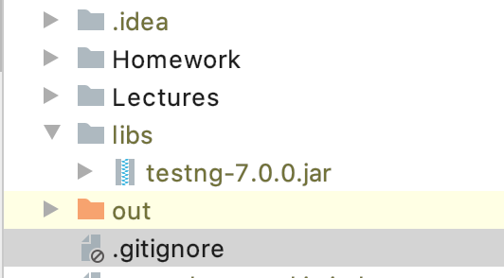
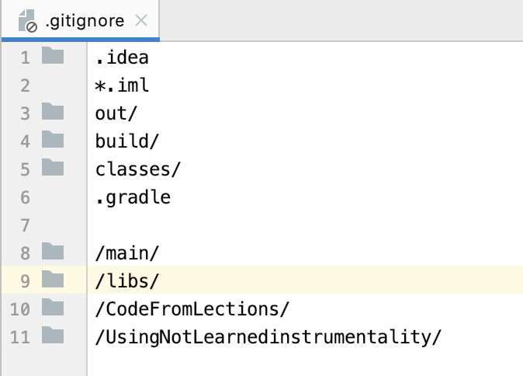
Only commit code that compiles

Slide 3

Commit atomically

Slide 4
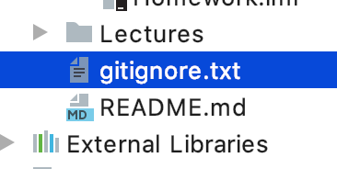

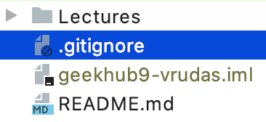

Do not track non business code

Slide 5
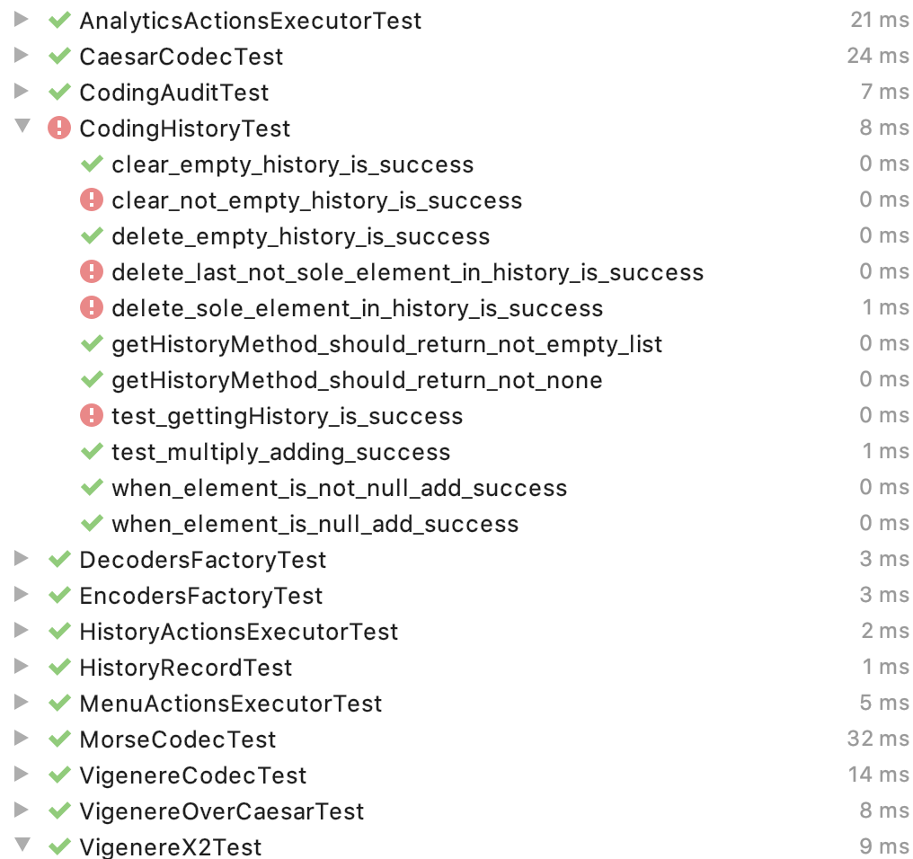
Push only “GREEN” instead of ”RED” tests

Slide 6
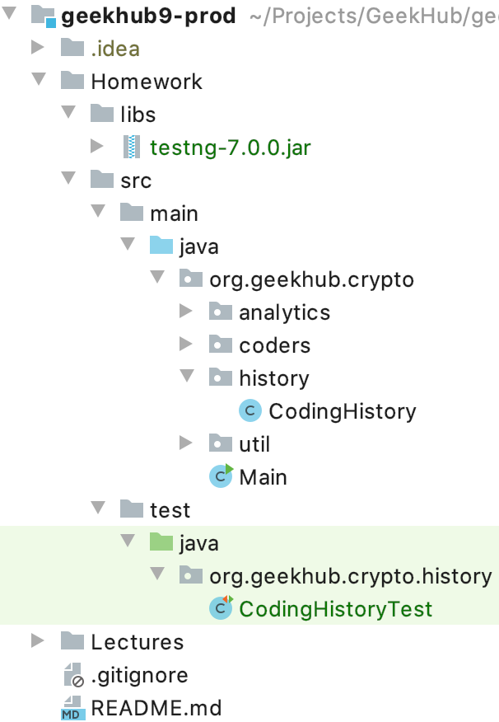
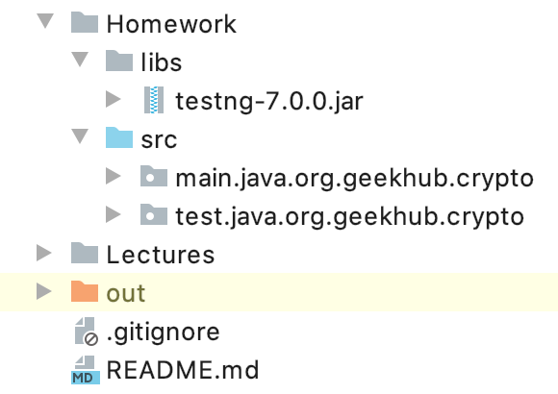
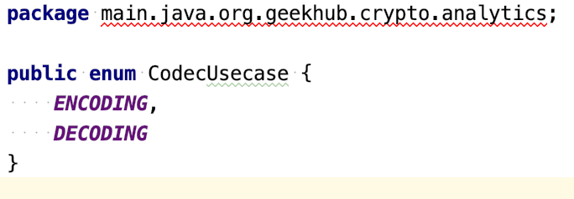
Follow correct code structure

Slide 7
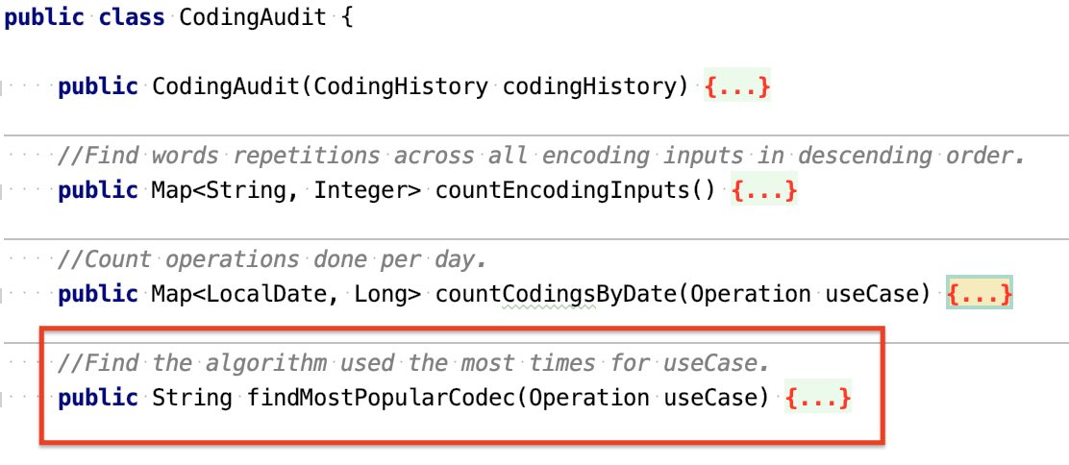
Avoid usage of “Dynamic things”

Slide 8
Keep original specification

Slide 9

Dangerous Enum::ordinal

Slide 10

Code coverage matters

Slide 11

Use effective data structures: EnumMap

Slide 12

Pay attention on types

Slide 13

toString and business code

Slide 14


Generics vs RAW types

Slide 15
Apply recommendations from personal feedbacks before starting next homework

